Slide 1

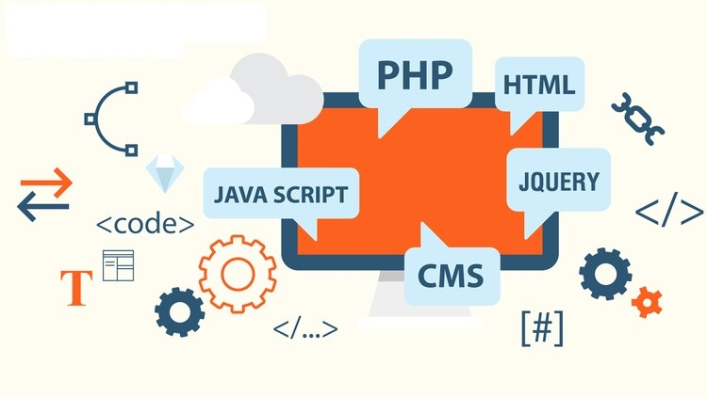
INTERNET PROGRAMMING
By
Teshome M.

Slide 2
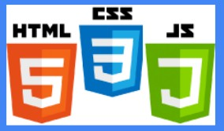
Chapter One
Introduction to Internet and the World Wide Web

Slide 3

The Internet
Network of networks that use the Internet protocol suite to link billions of devices worldwide
The Internet is a global system of interconnected computer networks
Consists of millions of private, public, academic, business, government networks
Networks linked together by electronic, wireless, & optical networking technologies
Carries information resources and services, e.g. WWW

Slide 4
Brief history of Internet
Began as a US Department of Defense network called ARPANET (1960s-70s)
APRPANET Main idea was to
support packet switching – allowing multiple users to use same communication path and
Use TCP (transmission control protocol) to ensure message is properly pass from sender to receiver
Initial services: electronic mail, file transfer
Opened to commercial interests and most universities in late 80s
WWW created in 1989-91 by Tim Berners-Lee
Early web browsers released: Mosaic 1992, Netscape 1994, Internet Explorer 1995
Amazon.com opens in 1995; Google January 1996

Slide 5
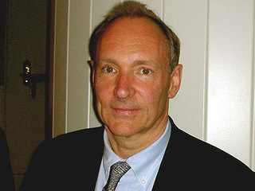
The Web
In 1989,Tim Berners-Lee of CERN (the European Organization for Nuclear Research) began to develop a technology for sharing information via hyperlinked text documents.
He also wrote communication protocols (Hypertext Transfer Protocol(HTTP)) to form the backbone of his new information system, which he called the World Wide Web.
The Web (World Wide Web) consists of information organized into Web pages containing text and graphic images.
It contains hypertext links, or highlighted keywords and images that lead to related information.
A collection of linked Web pages that has a common theme or focus is called a Web site.

Slide 6
Web fundamentals
The WWW comprises Web Servers and Web Browsers
Web Server: software that listens for Web page requests and serves up the requested pages
Apache - http://www.apache.org
Microsoft Internet Information Server (IIS) - http://www.iis.net/
Express - https://expressjs.com
Web browser: gets and renders documents from servers

Slide 7
Web fundamentals
Hyperlinks: used to reference other web pages, e-mail addresses, files and more…
URIs (Uniform Resource Identifiers)identify resources on the Internet
URIs that start with http://are called URLs (Uniform Resource Locators)
HTTP –hypertext transport protocol
application-level protocol for distributed, collaborative, hypermedia information systems
request/response protocol

Slide 8
HTTP
Defines a set of commands understood by a Web server and sent from a browser
Some HTTP commands (your browser sends these internally)
GET resource -- requests data from a specified resource
POST resource -- submits data to be processed to a specified resource
PUT resource -- uploads a representation of the specified URL
DELETE resource -- deletes the specified resource
Reading: HTTP status codes

Slide 9
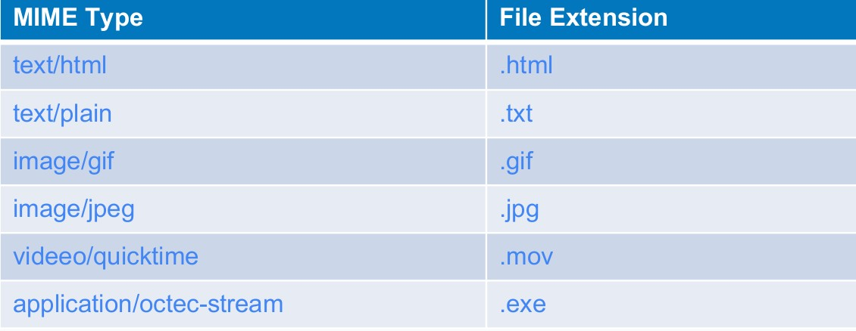
Internet Media Types (MIME)
Sometimes when including other resources in a Web page (stylesheet, image, multimedia object), we specify their type of data

Slide 10
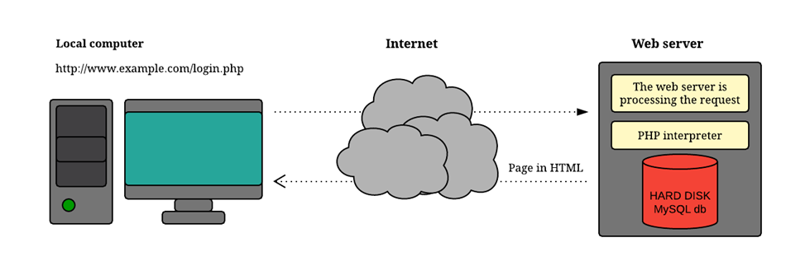
Web Client and server
Client = User agent. It is controlled by a user to operate the Web application.
A Web browser is the software that you run on your computer to make it work as a web client.
Web server: A Web server is a software that supports various Web protocols like HTTP, and HTTPS, etc., to process client requests.

Slide 11
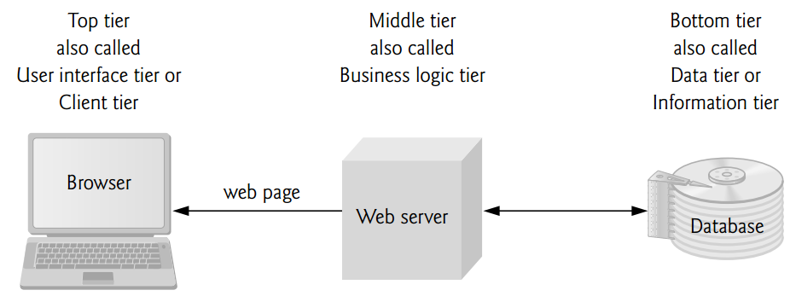
Multi tier application
Web-based applications are often multi-tier applications (sometimes referred to as n-tier applications) that divide functionality into separate tiers (i.e., logical groupings of functionality)

Slide 12
Multi tier…
The bottom tier (also called the data tier or the information tier) maintains the application’s data. This tier typically stores data in a relational database management system (RDBMS).
The middle tier implements business logic, controller logic and presentation logic to control interactions between the application’s clients and its data.
The middle-tier controller logic processes client requests (such as requests to view a product catalogue) and retrieves data from the database.

Slide 13
Multi tier…
The middle-tier presentation logic then processes data from the information tier and presents the content to the client.
Web applications typically present data to clients as HTML documents.
Business logic in the middle tier enforces business rules and ensures that data is reliable before the application updates a database or presents data to users.
Business rules dictate how clients access data and how applications process data.
The top tier, or client tier, is the application’s user interface, which gathers input and displays output.

Slide 14
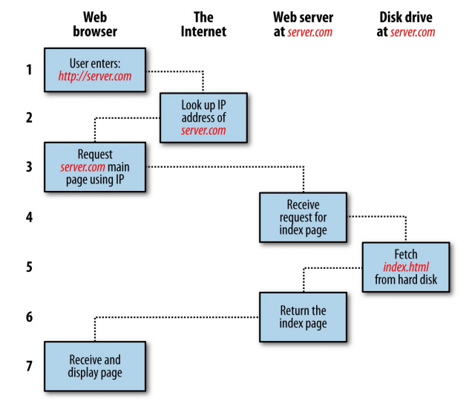
Request response procedure
The basic client/server request/response sequence

Slide 15
Request response…
Each step in the request and response sequence is as follows:
You enter http://server.com into your browser’s address bar.
Your browser looks up the IP address for server.com.
Your browser issues a request for the home page at server.com.
The request crosses the Internet and arrives at the server.com web server.
The web server, having received the request, looks for the web page on its disk.
The web page is retrieved by the server and returned to the browser.
Your browser displays the web page.
For an average web page, this process takes place once for each object within the page: a graphic, an embedded video or Flash file, and even a CSS template.

Slide 16
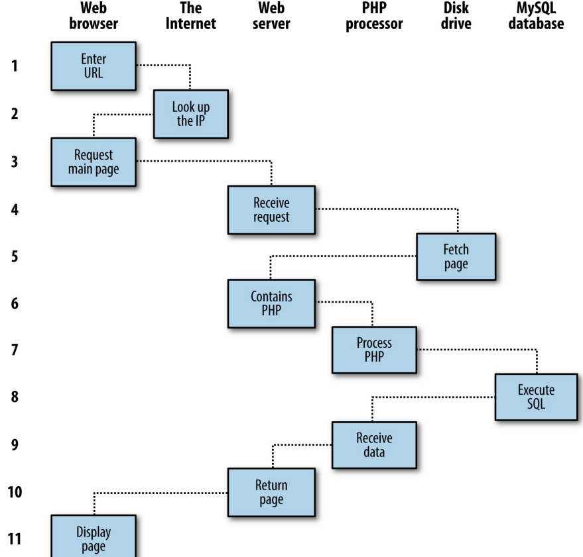
Request response…
A dynamic client/server request/response sequence

Slide 17
Request response…
You enter http://server.com into your browser’s address bar.
Your browser looks up the IP address for server.com.
Your browser issues a request to that address for the web server’s home page.
The request crosses the Internet and arrives at the server.com web server.
The web server, having received the request, fetches the home page from its hard disk.
With the home page now in memory, the web server notices that it is a file incorporating PHP scripting and passes the page to the PHP interpreter.

Slide 18
Request response…
The PHP interpreter executes the PHP code.
Some of the PHP contains SQL statements, which the PHP interpreter now passes to the MySQL database engine.
The MySQL database returns the results of the statements to the PHP interpreter.
The PHP interpreter returns the results of the executed PHP code, along with the results from the MySQL database, to the web server.

Slide 19
The HTTP Request Circle
A typical HTTP request / response circle: [www.w3school.com]
The browser requests an HTML page. The server returns an HTML file.
The browser requests a style sheet. The server returns a CSS file.
The browser requests an JPG image. The server returns a JPG file.
The browser requests JavaScript code. The server returns a JS file
The browser requests data. The server returns data (in XML or JSON).

Slide 20
Standard Web Technologies
World Wide Web Consortium (W3C) (https://www.w3.org/)
international consortium that develops and publishes open standards aims to ensure long-term growth of web
recommends a list of standard web technologies:
HTTP
HTML5
CSS3
JavaScript
DOM
PHP
MySQL
HTML

Slide 21
HTML
The public files on the web servers are ordinary text files, much like the files used by word-processing software.
To allow Web browser software to read them, the text must be formatted according to a generally accepted standard.
The standard used on the Web is Hypertext markup language (HTML).
HTML uses codes, or tags, to tell the Web browser software how to display the text contained in the document.

Slide 22
HTML…
HTML stands for HyperText Markup Language:
A markup language is a computer language that defines the structure and presentation of raw text.
In HTML, the computer can interpret raw text that is wrapped in HTML elements.
HyperText is text displayed on a computer or device that provides access to other text through links, also known as hyperlinks.

Slide 23
CSS
Cascading Style Sheets
Simple way to add style to your html and web documents
add color, whitespace, font, styling makes it possible
to separate the content from the presentation
share presentation rules across multiple pages
make accessibility easier to achieve
make responsive design easier

Slide 24
JavaScript
Client-side scripting language (mainly)
shares some syntax with Java, but is a distinct language
Imperative, interpreted, dynamically-typed, object oriented
JavaScript can
Change HTML Content
Change HTML Attribute Values
Can Change HTML Styles CSS
Can Hide HTML Elements
Can Show HTML Elements

Slide 25
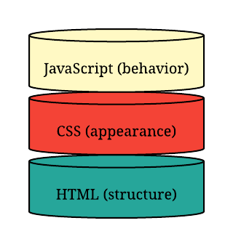
How the client side works

Slide 26
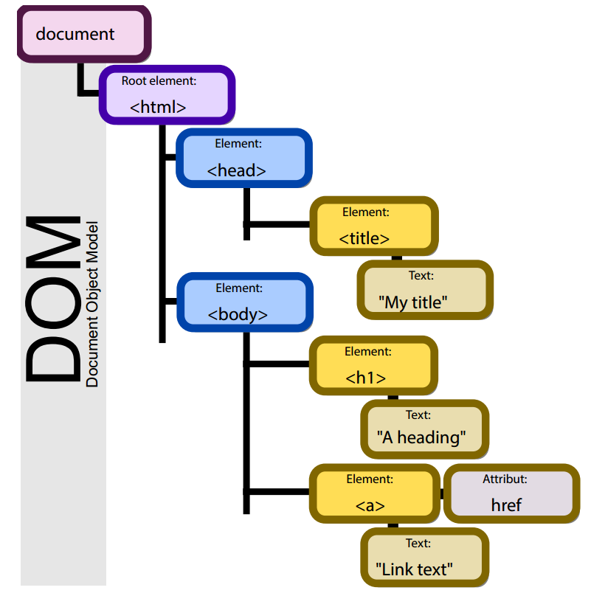
DOM
platform-neutral and language-neutral interface
lets programs/scripts dynamically access:
content
structure
Style
Treats XML, HTML, XTML document like a tree

Slide 27
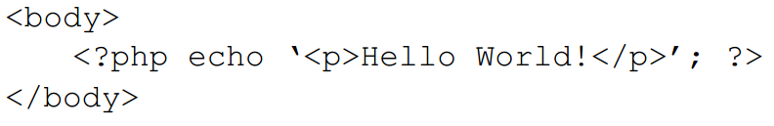
Server side scripting: PHP
PHP: Hypertext Preprocessor
used mainly for web development
can be embedded in HTML
typically interpreted
used to dynamically generate content
unlike JavaScript, is server-side

Slide 28
Web Server
Web servers are computer systems that deliver content or services to end users over the internet.
A Web server is also known as an Internet server.
It consists of a physical server, server operating system (OS) and software used to facilitate HTTP communication.
Example: Apache, IIS, Tomcat

Slide 29
Web Development Principles
It is important to create websites that are:
attractive
functional
user-friendly
Start with
what is the website?
what is the audience?
Design navigation based on audience and purpose
Provide multiple links from different contexts to vital parts of site

Slide 30
Web Development …
Keep it Simple Stupid (KISS)
avoid lots of video and audio
choose familiar and appropriate
fonts
colours
use contrast and whitespace
ensure fast load
use a fluid layout for different screen sizes
use open standards
test your site on many browsers

Slide 31
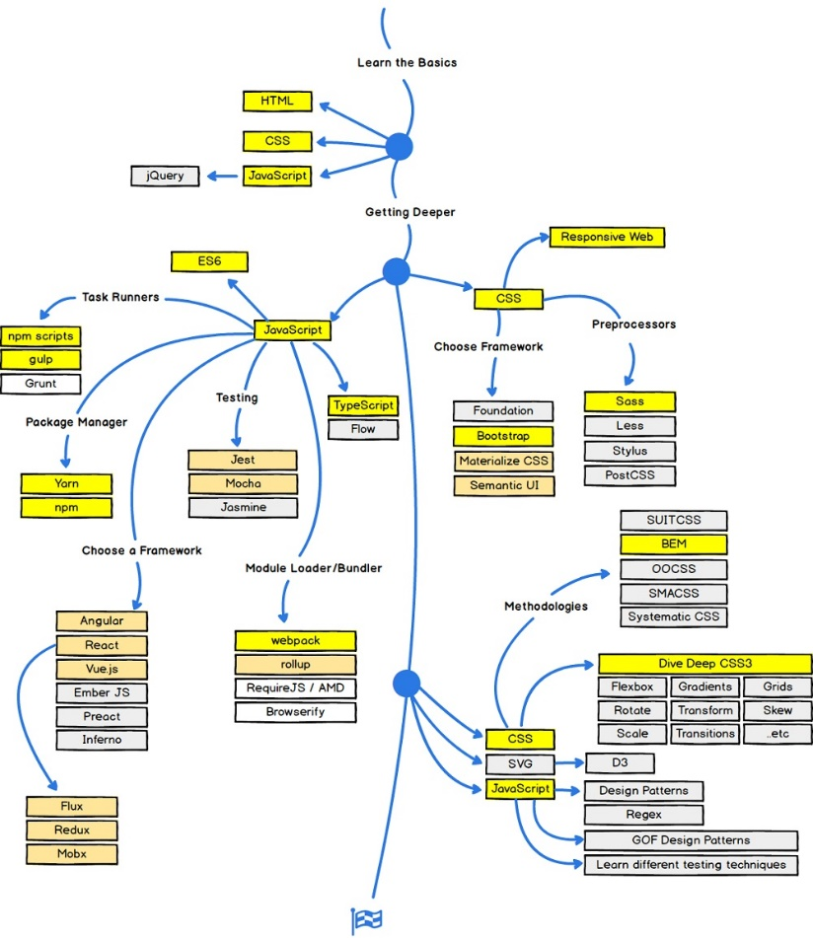
Front- end road map
Source: https://www.w3schools.com/whatis/default.asp

Slide 32
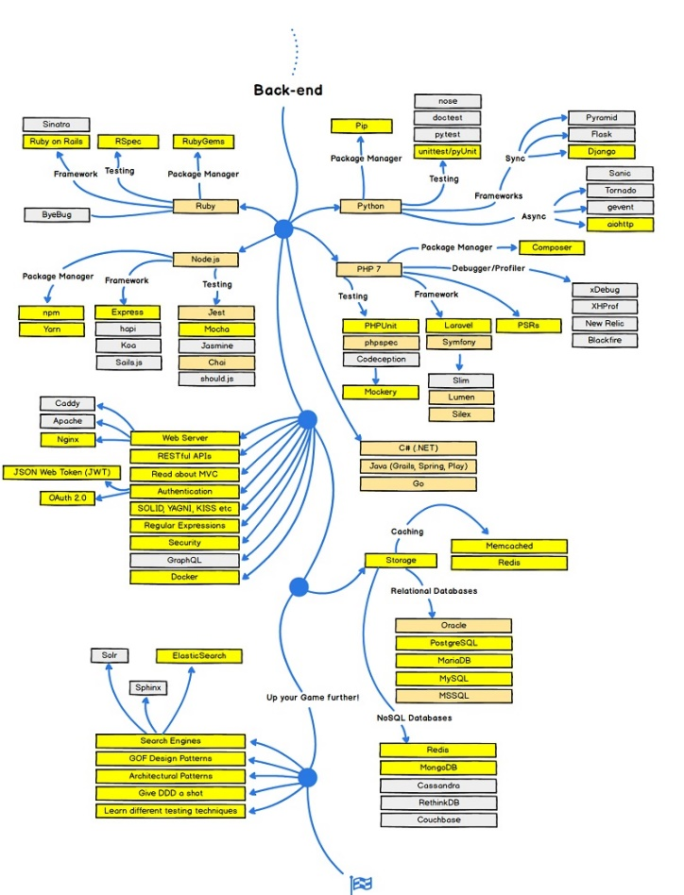
Back- end road map

Slide 33

Tools
Visual studio code
Sublime text
Notepad++
Atom
Brackets
Vim
TextMate
CoffeeCup
etc…

Slide 34
Reading assignment
IP addressing
DNS
https://developer.mozilla.org/en-US/docs/Web/API/Document_Object_Model/Introduction
https://developer.mozilla.org/en-US/docs/Web/API/Document_Object_Model

Slide 35
Web Programming
refers to the writing, markup and coding involved in Web development, which includes Web content, Web client and server scripting and network security.
The most common languages used for Web programming are XML, HTML, JavaScript, Perl 5 and PHP.
Web programming is different from just programming, which requires interdisciplinary knowledge on the application area, client and server scripting, and database technology.

Slide 36
Web programming can be briefly categorized into client and server coding.
The client side needs programming related to accessing data from users and providing information. It also needs to ensure there are enough plug ins to enrich user experience in a graphic user interface, including security measures.
To improve user experience and related functionalities on the client side, JavaScript is usually used. It is an excellent client-side platform for designing and implementing Web applications.
HTML5 and CSS3 supports most of the client-side functionality provided by other application frameworks.
The server side needs programming mostly related to data retrieval, security and performance. Some of the tools used here include ASP, Lotus Notes, PHP, Java and MySQL. There are certain 1.

